Slide 1

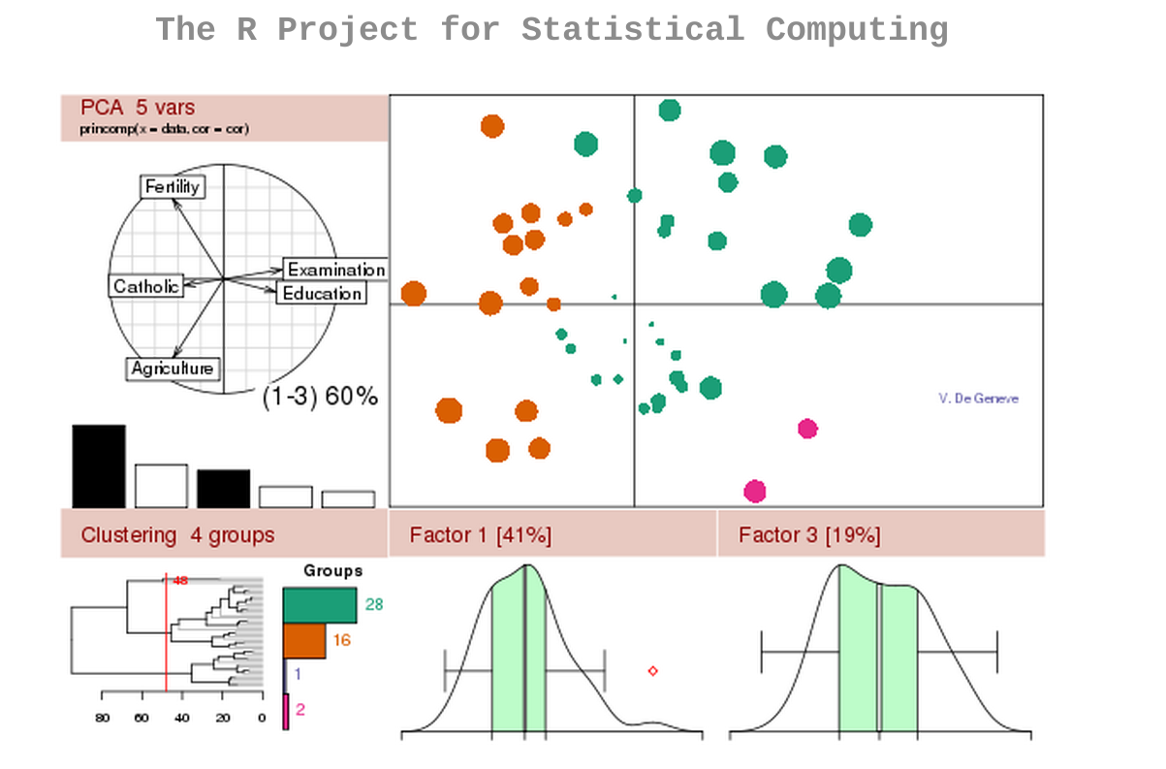
R language Introduction
>demo(graphics) >demo(persp)

Slide 2
Introduction
Features
  Data handling (especially statistics)
  Calculation with array and matrices
  Graphical facilities
  Packages (Packages developments)
Unix/Linux/Windows/MacOS

Slide 3
Books & Web
An Introduction to R
R for Beginners
Statistics with R
http://www.r-project.org/
http://www.bioconductor.org/
R blogger
https://www.coursera.org/course/compdata

Slide 4
Start with R
$R >q() >getwd() >setwd() >dir()
>help.start()
  >?plot() >help(plot) >example(plot) >help.search('pca')
Executing commands
  >source('plot.R')
  $~/Documents/R-2.10.1/bin/R --no-save < plot.r > /dev/null
>ls() >object() >rm()
>install.packages('vioplot') >library(vioplot)
R CMD INSTALL FDAtools_SAE2 (old version)

Slide 5
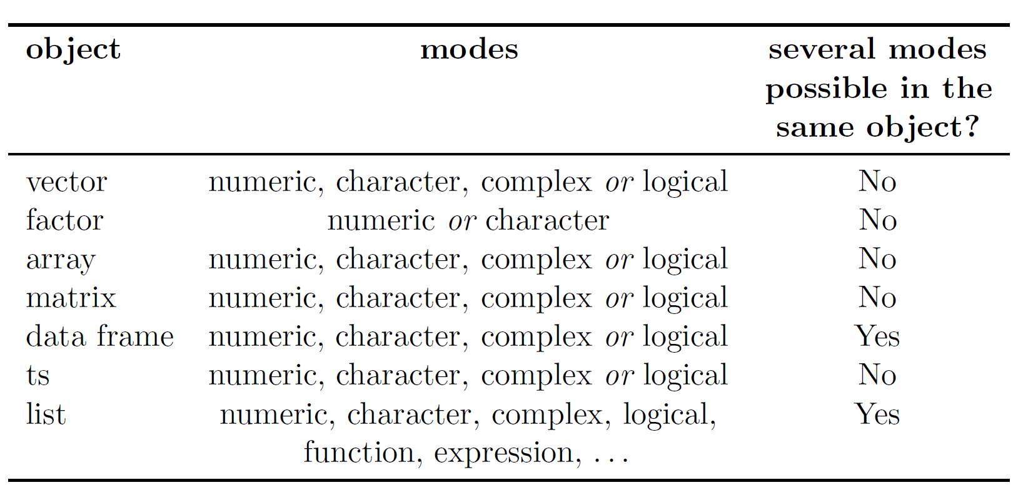
Data with R
Types of objects
>class() >mode() >dim() >length()

Slide 6
Data with R
Read/write data
  >read.table() >read.csv() >read.fwf() >scan() >load()
  >write.table() >write() >save()
Generating data
  ->
  >x<-1:30 >seq() >rep() >sequence() >gl()
  >expend.grid()
  >x<-c() >x<-list() >x<-data.frame() >x<-matrix()

Slide 7
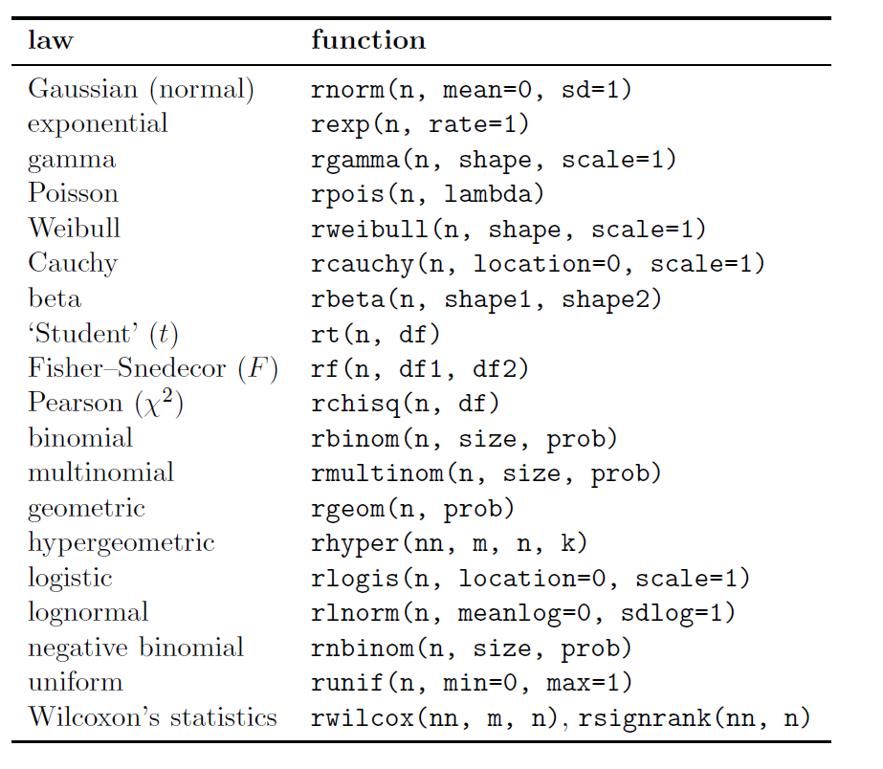
Data with R
Random sequences

Slide 8
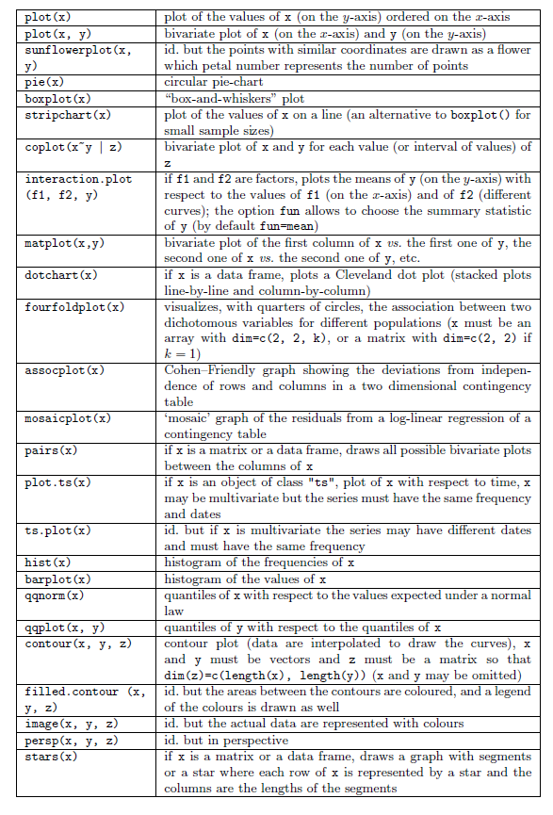
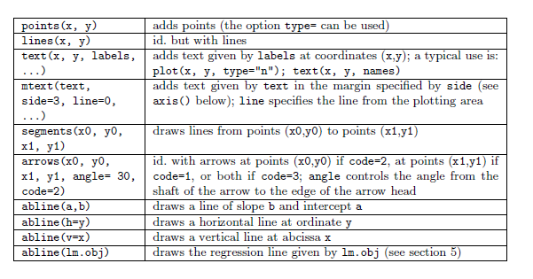
Graphics with R
>demo(graphics)
>plot(1:100) >barplot(1:100)
>pie(1:100) >hist(1:100)
>pdf() >png() >dev.off()

Slide 9
Statistical analyses with R
Basic operations
  +, -, *, /, %/%, ^, exp, mean, median, sd, var, sqrt, max, min...
Tests

Slide 10
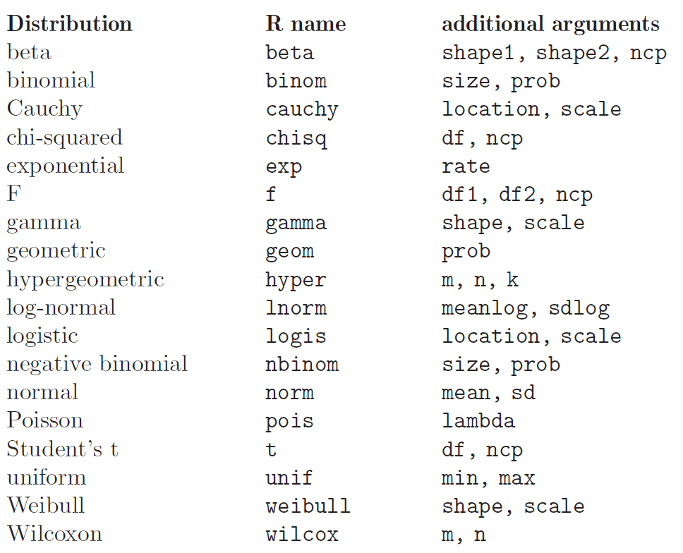
Statistical analyses with R
Probability distributions in R

Slide 11
Statistical analyses with R
Student's t test example
  >rnorm(100,2,1)->x
    >hist(x,prob=T) >lines(density(x),type=T,col=2)
  >rnorm(100,2,1)->Y
  >t.test(x,y)->result.t
  >attributes(result.t)
  >result.t$p.value

Slide 12
Statistical analyses with R
Analysis of variance (ANOVA) >aov
>lm()
>glm()

Slide 13
Functions

